Slide 1
Digital Democracy
Raina Kolluri, Anna Ekholm, Avni Kakkar

Slide 2
Introduction
Raina Kolluri
Anna Ekholm
Avni Kakkar
Within digital democracy, our specific interest was in Political Education and Engagement.

Slide 3
What did we ask?
On a scale from 1 to 10 how interested are you in politics?
How educated do you feel about your elected representatives?
Where do you find most of your political information?
Do you feel connected to your elected officials?
How do you learn about candidates’ positions?
Do you currently donate to candidates for offices?
Do you ever feel overwhelmed or disenfranchised by politics?

Slide 4
Who did we Interview?

Slide 5
Participants
Vikram
Christie
Tasmia
Samantha

Slide 6
Results

Slide 7

“News has to be worth your time consuming.”

Slide 8
“I feel disconnected when I hear about news that I didn’t know about. I feel like I should have known them.”

Slide 9
“I feel like if I cared enough I would know who [my local representatives] are, but I don’t.”

Slide 10
“Do I vote for someone my parents are voting for or my friends are voting for?”

Slide 11
What did We learn?

Slide 12
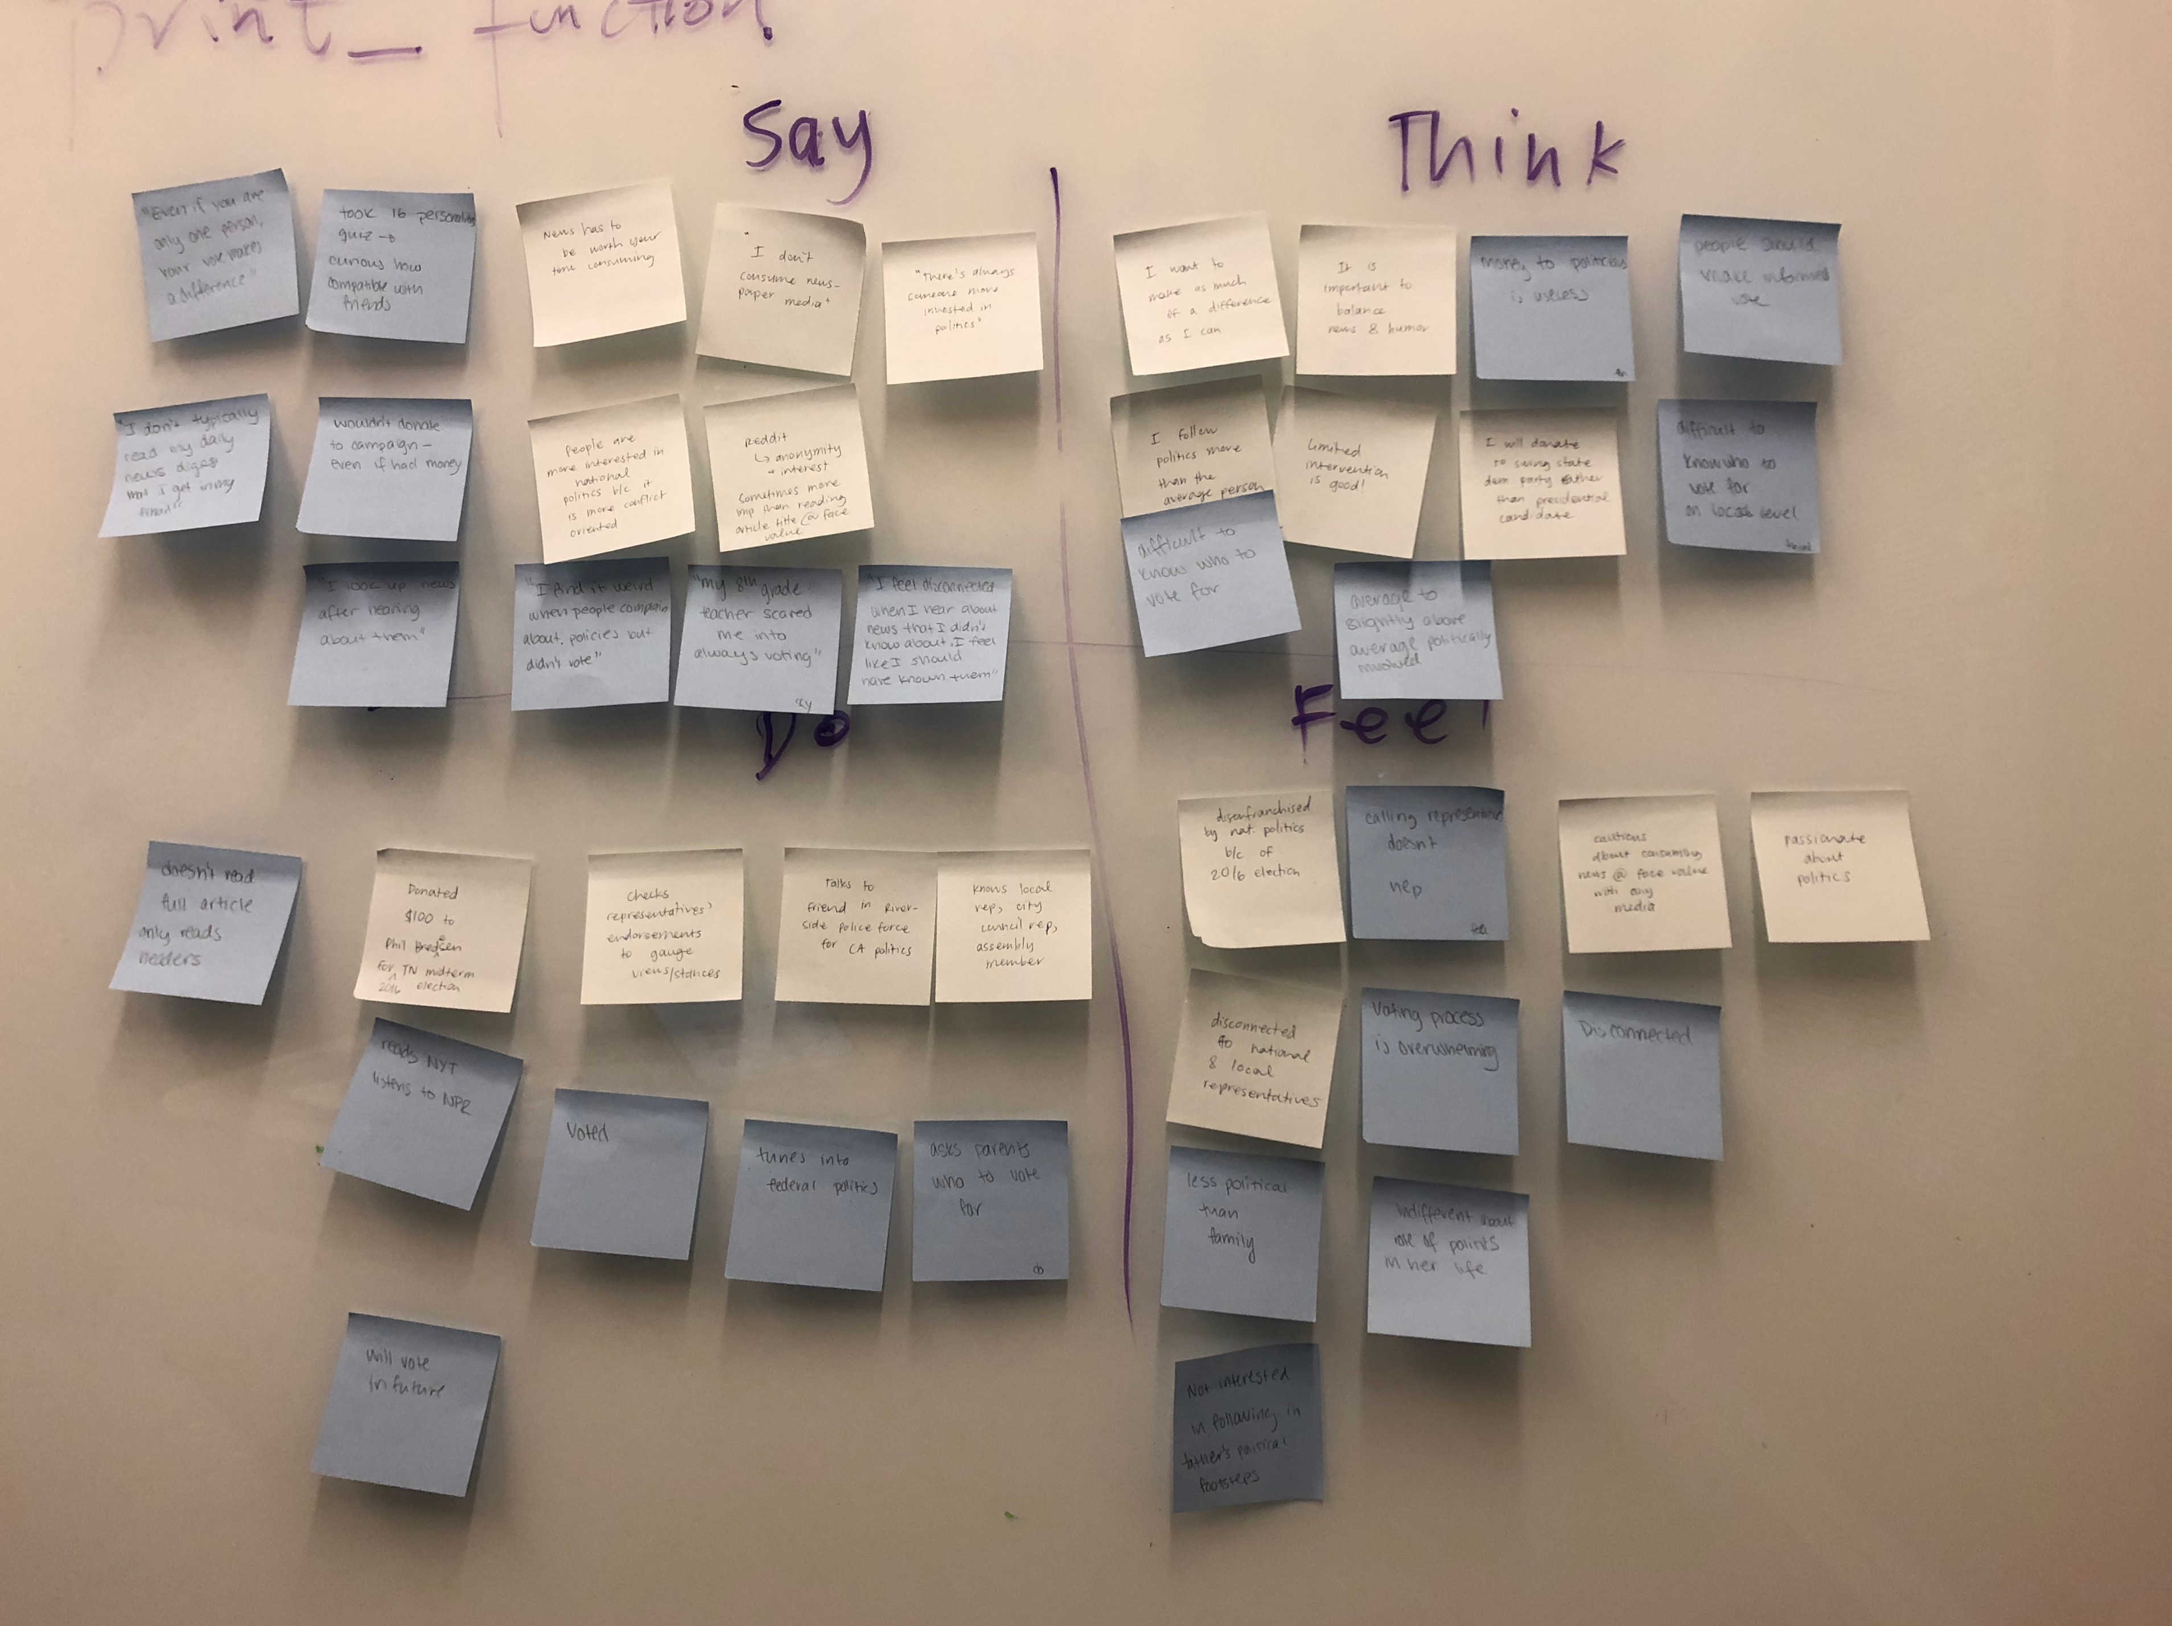
Empathy Map

Slide 13
Empathy Map
Say
Think
“Even if you are only one person, your vote makes a difference.”
“Essentially, I’ll hear about stuff first and then go read about it.”
“I don’t consume newspaper media.”
“It can be alienating and confusing because there’s a lot of different people who all seem the same and you have to pick between them.”
It’s important to balance news and humor
Donating to politicians is useless
Only matters to donate to swing state politicians
Difficult to know who to vote for, especially on a local level
Local elections are insignificant
Do
Feel
Checks representatives’ endorsements to gauge political views and stances
Doesn’t read full articles – only headlines
Study before a voting cycle, but don’t keep up regularly
Lost interest after 2016 election
Gets most news from social media
Guilty about not keeping up to date
Disenfranchised with the government after 2016 election
Less politically inclined than their family
Cautious about consuming news at face value through all mediums
Insignificant when calling representatives

Slide 14
Contradictions and Surprises
It’s your civic duty to vote, but it doesn’t feel like it makes a difference
Social media has become a primary news source for many
At least two interviewees didn’t know their local representatives, nor their senators and house representatives
Family influences politics and interest in politics
Vikram never solely reads headlines, but Christie exclusively reads headlines, and often neglects the article

Slide 15
Initial insights

Slide 16
Insight Need
People find it difficult to connect with their local and national representatives
Easily digestible information about their representatives and their positions

Slide 17
Insight Need
Following news is a time commitment that can be boring or seem unreliable
News presented in a factually correct but still entertaining and engaging manner

Slide 18
Insight Need
Starting the conversation of empowerment and education of young voters earlier
Young voters tend to follow their parents’ views

Slide 19
Insight Need
General disinterest with the political system and election process
Education tailored to young people in a more exciting way that emphasizes it’s importance

Slide 20
Summary

Slide 21
We interviewed three young voters and one experienced and involved voter.
We saw similarities…
A disconnect from their federal and local representatives
A want to consume media in a more accessible format
Preference to be entertained by their news, otherwise it feels like a chore.
… but also differences.
The young voters struggle with who to vote for while the experienced voter engages in political conversation online
The younger voters typically only engage when its voting season
They are fairly uninformed about the political process

Slide 22
Thank you!
Questions?

